Slide 1


Engineering Exploration – Introduction to Internet of Things (23EE001)
Presentation
on
Smoke Detector
Chitkara University School of Engineering and Technology,
Chitkara University, Himachal Pradesh

Slide 2
Project Members
Group - 5(G11)
Name of Student1 Id : Kousik Adak (2211981201)
Name of Student2 Id :Krishna Gopal Pradhan (2211981203)
Name of Student3 Id : Krishnendu De (2211981205)
Name of Student4 Id : Jishu Adhikary (2211981185)
Name of Student5 Id : Kausik Kumar Sahoo (2211981197)
Under the supervision
of
Dr. Monika Parma

Slide 3
Idea/Approach Details
Sensor Integration: Incorporate specialized gas sensors (e.g., for detecting
methane, carbon monoxide, LPG) into the smart smoke detector to enable
multi-gas detection capabilities.
Microcontroller Integration: Utilize a microcontroller (such as Arduino,
ESP8266, or ESP32) to process the sensor data and control the detector's
operations.
Blynk Cloud Setup: Set up a Blynk account and create a project on the
Blynk cloud platform. Obtain the authentication token for the project.
Hardware Connections: Connect the microcontroller to the gas sensors and
configure the necessary hardware connections. Ensure proper power
supply and data transmission between the components.
Notification Setup: Configure the Blynk app to receive notifications when
gas levels surpass the predefined thresholds. This can include push
notifications, emails, or SMS alerts, depending on your preference.

Slide 4
Technology Used
Our Smart Smoke Detector merges cutting-edge smoke detection with OLED display
and Blynk integration for an advanced and user-friendly solution. Advanced Detection:
Utilizes state-of-the-art technology for accurate and early smoke detection.
Blynk Integration:
Seamless IoT connectivity for remote monitoring and control via Blynk app.
Mobile Control:
User-friendly mobile app for configuration, status checks, and remote alerts.
Wireless Connectivity:
Connects to home Wi-Fi for easy integration into smart home systems.
Sound Alerts:
Additional notification through voice alerts for enhanced user awareness.
Sleek Design:
Modern design for seamless integration into home aesthetics.
Energy-Efficient:
Optimized power management for extended battery life.
Easy Installation:
Simple setup for DIY or professional installation.

Slide 5
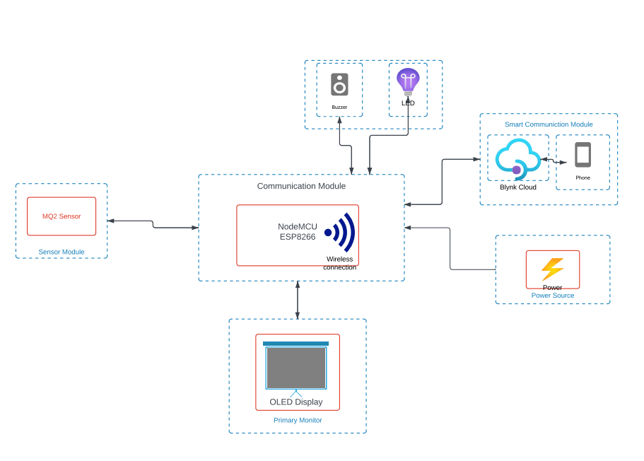
Design Of the Project
Fflo

Slide 6
Applications of the Project
Residential Safety:
Provides early detection of smoke and potential fire threats in homes, ensuring prompt alerts for timely evacuation.
Mining:
Our smart smoke detector utilizes state-of-the-art sensors capable of detecting a wide range of harmful gases commonly found in mining environments, including methane, carbon monoxide, hydrogen sulfide, and more.
Fire-Works Factories:
The application of a smart smoke detector equipped with harmful gas detection in firework factories ensures proactive monitoring and early detection of hazardous gases, significantly improving safety measures to prevent potential accidents or health risks for personnel and the facility. Smart Home Integration:
Seamlessly integrates with existing smart home systems, allowing users to incorporate smoke detection into their overall home automation.

Slide 7
Questions???
ANY QUERIES?

Slide 8
THANK YOU

